Slide 1
VEHICLE RESALE PREDICTION
BY
KHAJA MOHIDDIN
MIR NASAR ALI
SANDEEP
CHAITHANYA
RAVI
BATCH-5

Slide 2
INTRODUCTION
Regression analysis consists of a set of machine learning methods that allow us to predict a continuous outcome variable (y) based on the value of one or multiple predictor variables (x).
Briefly, the goal of regression model is to build a mathematical equation that defines y as a function of the x variables. Next, this equation can be used to predict the outcome (y) on the basis of new values of the predictor variables (x).
Linear regression is the most simple and popular technique for predicting a continuous variable. It assumes a linear relationship between the outcome and the predictor variables.

Slide 3
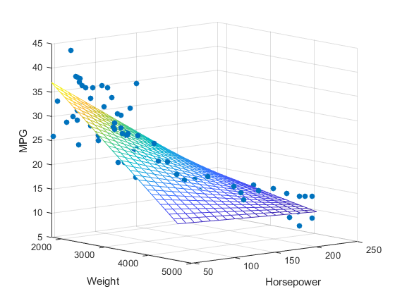
Why Regression is important?
Regression analysis is all about data. It helps businesses understand the data points they have and use them – specifically the relationships between data points – to make better decisions, including anything from predicting sales to understanding inventory levels and supply and demand.
Of all the business analysis techniques, regression analysis is often referred to as one of the most significant.

Slide 4
Problem Process
This Problem Is Solved Using ANN
In This The Dataset That We`ve taken was Pre Processed And Then ANN Was Applied
For The UI Application We`ve Used Node_RED Which Is Already A Library File In Python Which helps Us To Provide the User Interface For The Written Code

Slide 5

Important libraries in dataset
Numpy provides a high-performance multidimensional array and basic tools to compute with and manipulate these arrays
Pandas is an open-source, BSD-licensed Python library providing high-performance, easy-to-use data structures and data analysis tools for the Python programming language
sklearn is used for doing preprossing and OneHotEncoder
matplotlib.pyplot is used for to predict the graph between the dependent and independent variables

Slide 6
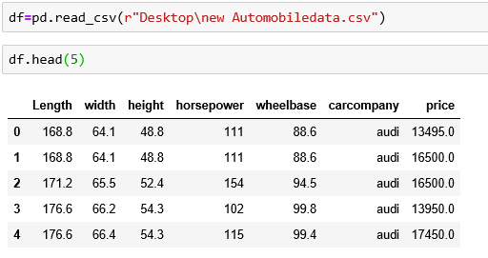
The Data Set of Automobile

Slide 7
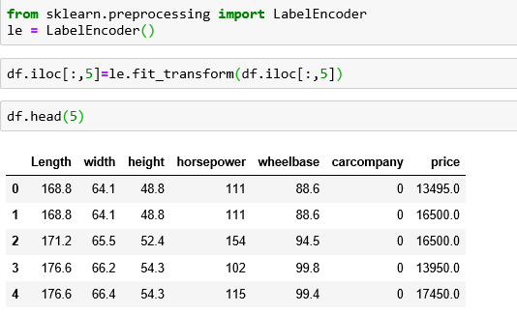
Why do preprocessing?
To change the string values into the int values we use preprocessing.

Slide 8
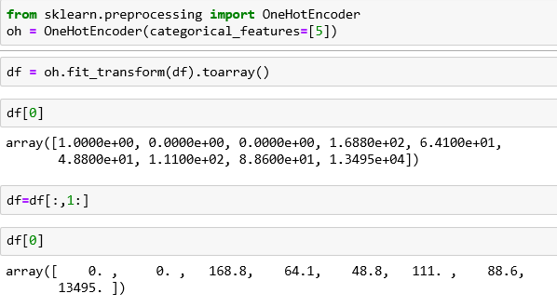
Why to do OneHotEncoder?
By using OneHotEncoder we can change the total DataFrame into Spalse Matrix and then by using categorical total data frame into array formate and then we have to remove the dummy variable.

Slide 9
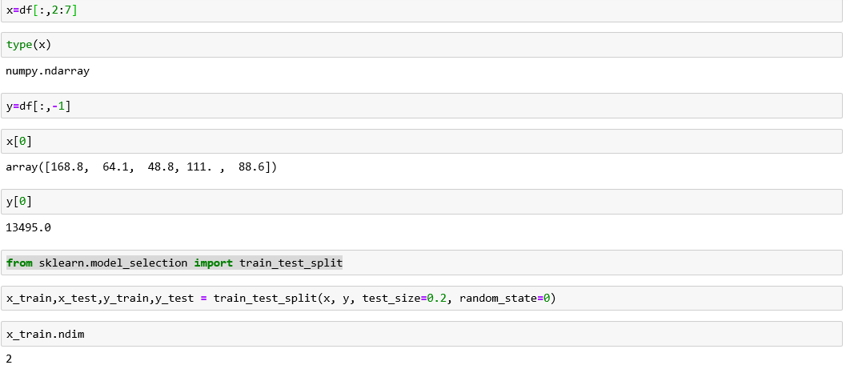
Now, Split the combined dataframe to trainning data and test data

Slide 10
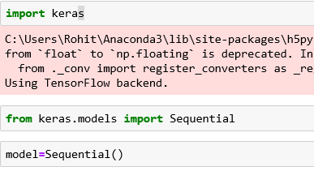
Make the Neural Network
To make the Neural Network we have to import the library function called keras which is tensorflow backend.
And, Then we have define a sequential model.

Slide 11

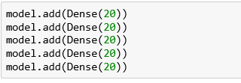
Make the Input layer of ANN model
Make the Hideen layer of ANN model

Slide 12
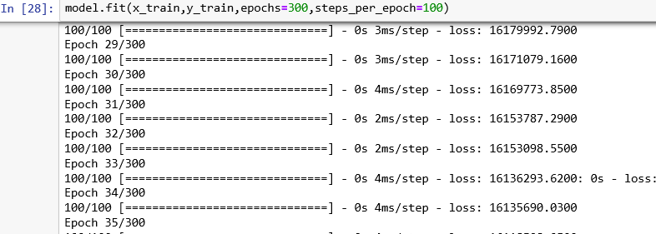
Make of out put layer of ANN model
Now, compile the ANN model
Now, Train the ANN model

Slide 13
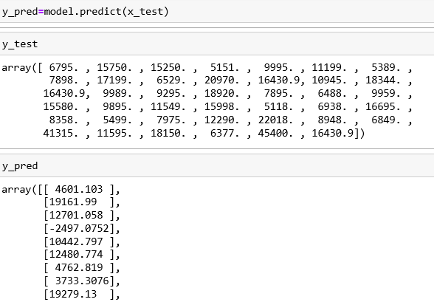

Predict the model
analyse the model

Slide 14
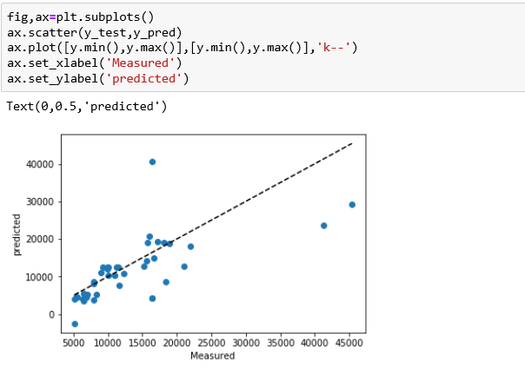
Plot the Graph
Now, Save the model

Slide 15
How to create a UA application?
Go to the catlog , then we have the AI categorie in tha categorie we found the watson studio and machine learing in that we need to create the individual server's.
Then we have to acess the watson studio in machine learing.
In that create a project and in that project create a jupyter notebook.
Then we have to add the file which we have already done in jupyter notebook and set the language as python 3.5 free.
After we have to import the data set file into that note book.
After that we have to install the Watson Machine Learning Client and we need to import the WatsonMachineLearningAPIClient.
After that we need to add the servies credentials of watson stuido, then we have to deployment the creation and we have to create the scoring endpoint link.

Slide 16
How to create a Node-RED app?
Go to the search box and type Node-RED that we found the Node-RED Starter cloud foundary app then we have to create a app.
After creating the app. Then we have to click the visit app url.
Then click the Node-RED floe editor.
Then we have install the required function in the node-RED flow. Then we have to import the json file or we have to create the flow by using the node's input, output, debug , text, function,... etc.
After creating a flow we need to deploy it, then we out the output of it by that we can enter the value and predict the value which we want.

Slide 17
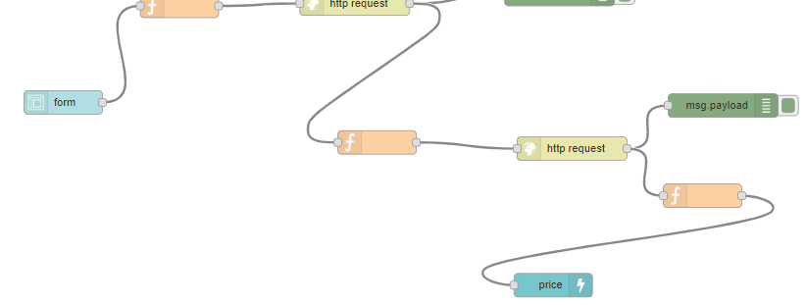
Node-RED flow

Slide 18
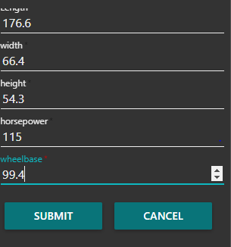
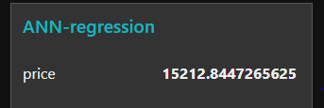
In put and Out put of Node-RED flow

Slide 19
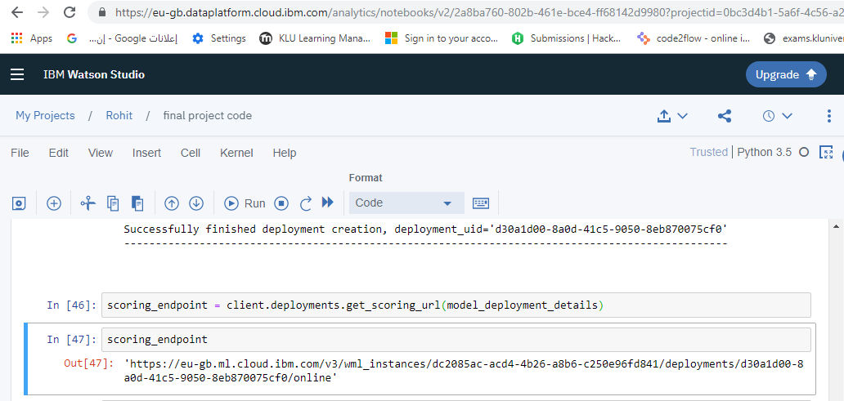

How we connect UA appliction and Node-RED?
For the UA application we have to create a scoring endpoint link then that link will use as the connection between the UA application and Node-RED application.
we have to add the link in the http request node.

Slide 20
Conclusion
By using the regression we can easily predict the future values of any product like from stock market we need predict the future market price of the products from the present price.In this project we need predict the price of the car (Independent variable) from the length, height, width, wheel base, horsepower of the car(dependent variables).

Slide 21



